Slide 1

SIR Model: Puffer’s Disease
By: Kay, Sam, Naren, Sophie

Slide 2
Why’d we choose the SIR Model
(ODE Edition)
Keep it simple stupid!
  Leaves room for creativity
  Plenty of background knowledge on SIR model
  Allows us to change more parameters and experiment more
  Make a simple model more complicated (not fun, but cool to mess around with)
  Can work the hardest on a topic well known
Interesting topic
  Studying effects of steepness of negative feedback loops
  Too much ecology in LS 7B, gotta switch things up

Slide 3
How’d we come up with Puffer’s Disease?
Met up together and chose the SIR model (reasons discussed previously)
Added a new state variable (infectious but not symptomatic)
Came up with a cool name for the disease
Wanted to incorporate other aspects real life diseases into our model
  Incorporated a vaccine
  Used parameters that have values according to real life
    Susceptible people have a 2% chance more of becoming infected from symptomatic individuals than asymptomatic individuals
    Individuals will always be asymptomatic before they become symptomatic
Made the flow diagram, model assumptions, and parameters accordingly

Slide 4
Puffer’s Disease Model
In epidemiology, a common way to model the spread of an infectious disease called Puffers Disease is to track the number of susceptible individuals (S), the number of individuals of those who are infectious but not yet symptomatic (N), the number of currently infected and symptomatic individuals (I), and the number of individuals who have recovered from the disease with immunity (M). (All rates listed below are per day rates)

Slide 5
Puffer’s Disease Parameters and Assumptions
Asymptomatic infected individuals begin to exhibit symptoms after a 4 day period. In other words, 25% of the asymptomatic individuals become symptomatic each day.
  Parameter p: rate at which asymptomatic individuals become symptomatic
Newly infected asymptomatic individuals die at a per capita rate of .0001
  Parameter q: per capita death rate of newly infected asymptomatic individuals
Susceptible people can gain immunity by getting vaccinated. The per capita rate at which susceptible people choose to get vaccinated occurs at 0.07
  Parameter r: per capita rate of susceptible individuals getting vaccinated
People immune to the disease through vaccination or exposure both gradually lose their immunity over the course of 6 months; in other words, the per capita rate of immune (M) individuals becoming susceptible again is about .006
  Parameter t: per capita rate of immune individuals becoming susceptible again
Susceptible people become infected in 3% of encounters with asymptomatic individuals.
  Parameter g: Per capita rate at which susceptible people become infected with encounters with asymptomatic individuals
7% of encounters between susceptible and infected and symptomatic individuals result in new infections.
  Parameter h: per capita rate at which susceptible and infected+symptomatic individuals result in people becoming infected
Infected and symptomatic people die at a per capita rate of 0.0005.
  Parameter j: per capita death rate of infected and symptomatic individuals
Infected and symptomatic people recover at a per capita rate of 0.5
  Parameter k: per capita recovery rate of infected and symptomatic people
When people recover they become immune to the disease
Newly infected individuals do not immediately exhibit symptoms and are initially asymptomatic. (meaning: All susceptible individuals that become infected will become infectious but not symptomatic before passing away or becoming infectious and symptomatic)

Slide 6
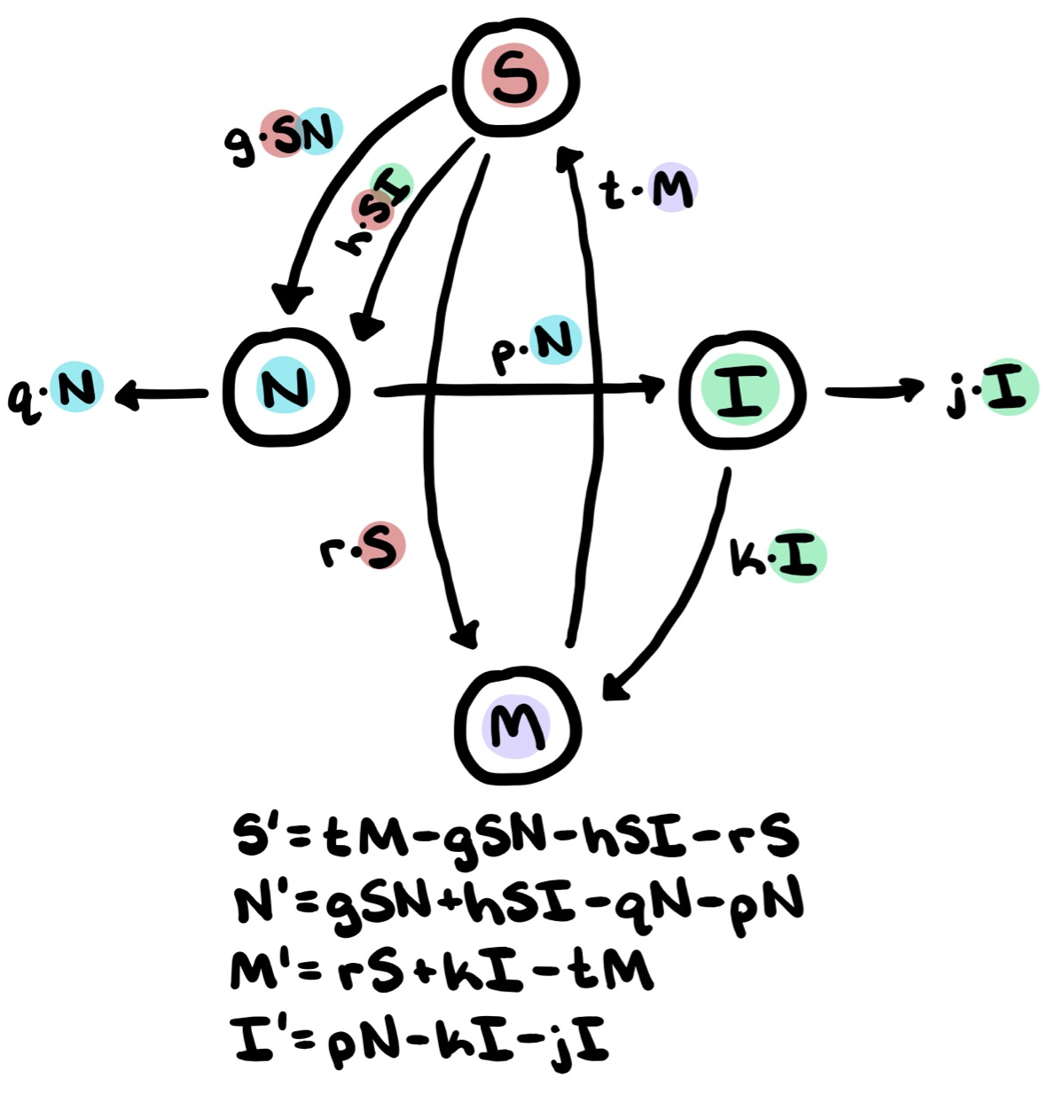
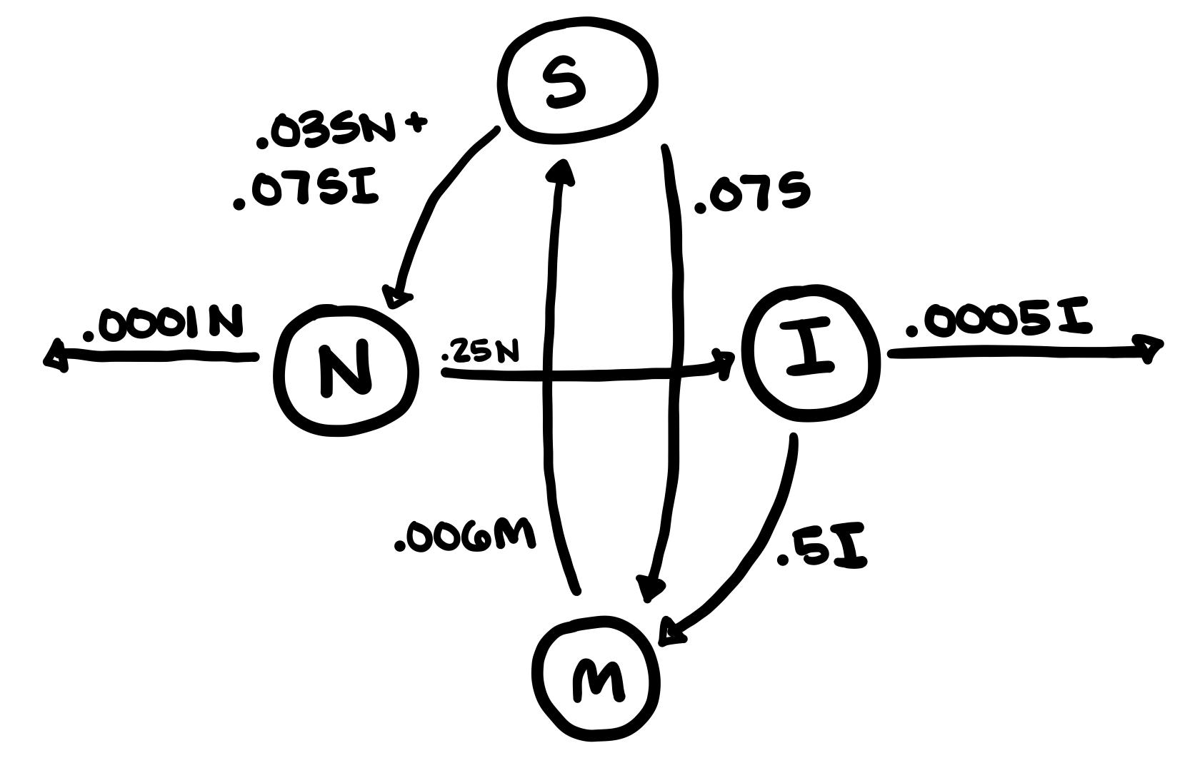
Flow Diagram
ODE equations with specified numbers:
S’= 0.006M -.03SN - .07SI - 0.7S
N’= .03SN + .07SI -.25N - 0.001N
I’= 0.25N - 0.0005I - 0.5I
M’= .07S + .5I - .006M
Notes:
We made a list of assumptions and their corresponding parameters for our model of Puffer’s disease, and the flow diagram illustrating them can be seen on the following slide. The sum of the terms g*SN and h*SI (on the top left) represent the total number of susceptible individuals that become infected. Because all newly infected people take time to develop symptoms, all of these individuals leave popn S and join population N. Parameter g is the rate at which susceptible individuals become infected but not yet symptomatic, which occurs when an S individual encounters an infected but not yet symptomatic person (from population N), an occurrence described by the term S*N. Parameter h is that rate at which any given susceptible individual will join population N when they encounter a symptomatic and infected individual (from population I).
The parameter p represents the per capita rate at which infected (but not yet symptomatic) individuals become symptomatic. For instance, if it takes four days for individuals who have become infected to begin showing symptoms, p will be .25, as about a quarter of the not yet symptomatic population will have been infected for four days at that point.
M represents the population that is immune, and so the term tM describes the rate at which immune become susceptible again as immunity from the vaccine and recovery from the disease wears off. Additionally, r describes the rate at which susceptible individuals get vaccinated, and k is the rate at which individuals recover from the infection after they have begun showing symptoms, become immune.
J and q both represent death rates; j is the death rate of infectious, symptomatic individuals (from popn I), and q is the death rate of not yet symptomatic individuals. In our model, j is slightly higher than q, and so the death rate is higher among those exhibiting symptoms.
The diagram on the right represents the same series of interactions, but with possible values as the set parameters. The corresponding differential equations for the four populations can be seen above; for instance, S’ is [read].

Slide 7
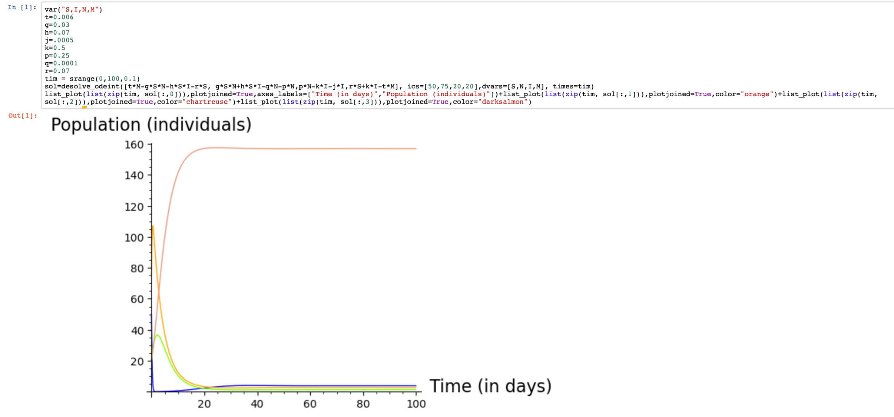
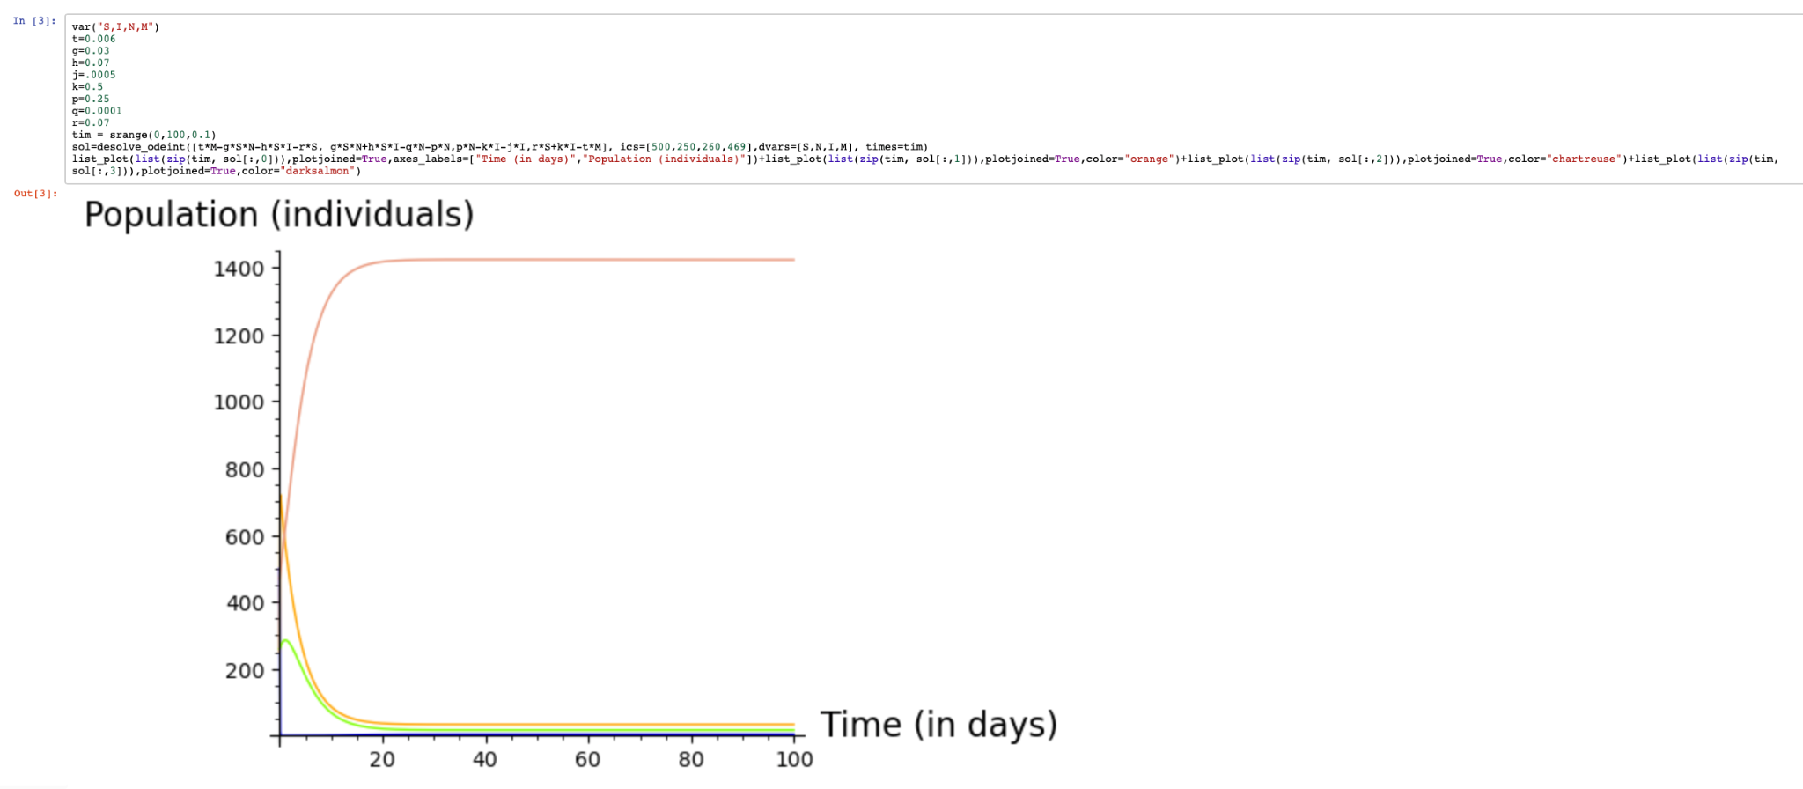
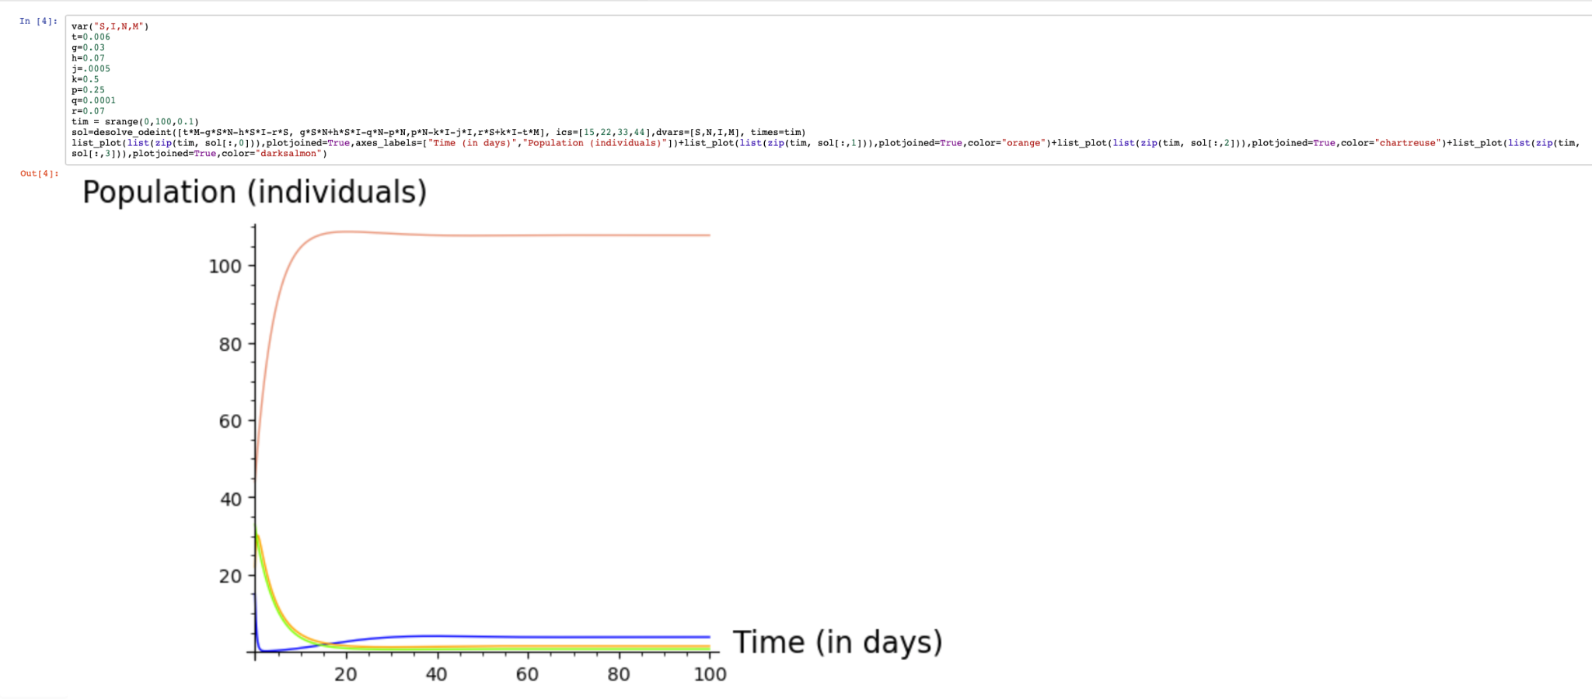
Simulations: Differing initial conditions
Dark Salmon: Immune
Orange: Infected but not symptomatic
Chartreuse: Infected and symptomatic
Blue: Susceptible

Slide 8
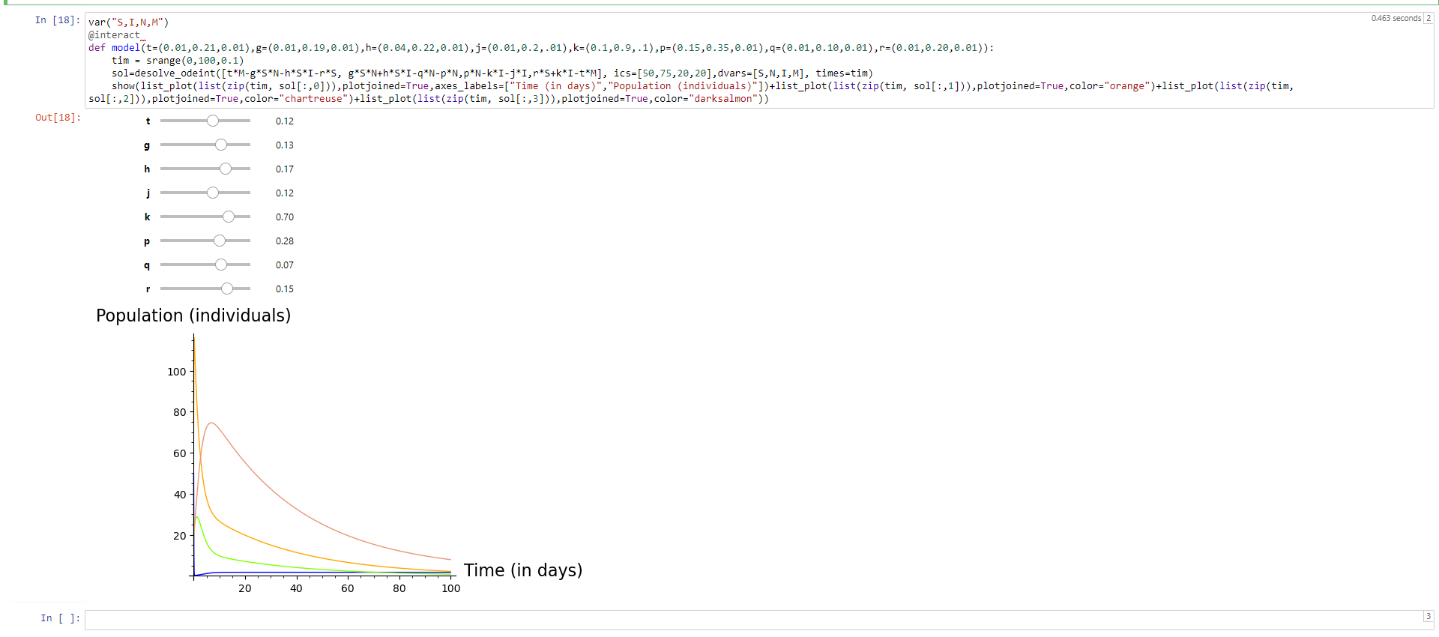
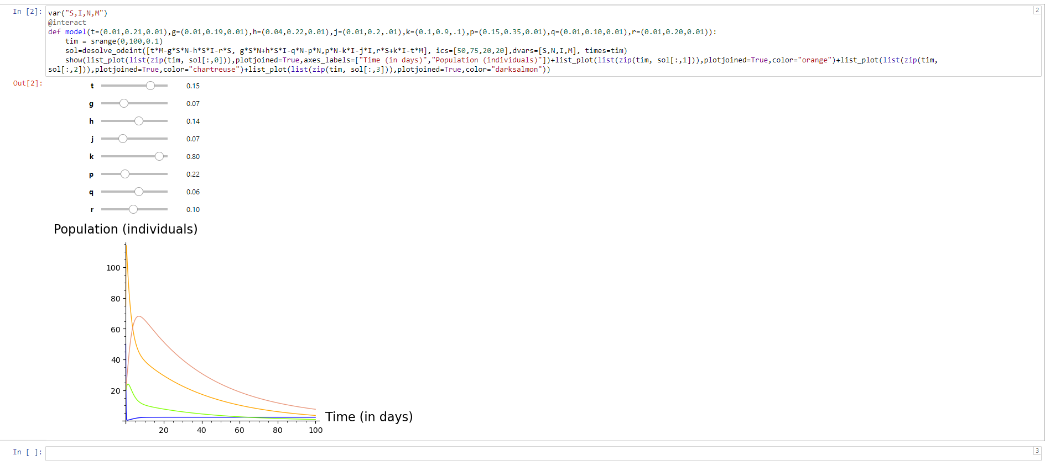
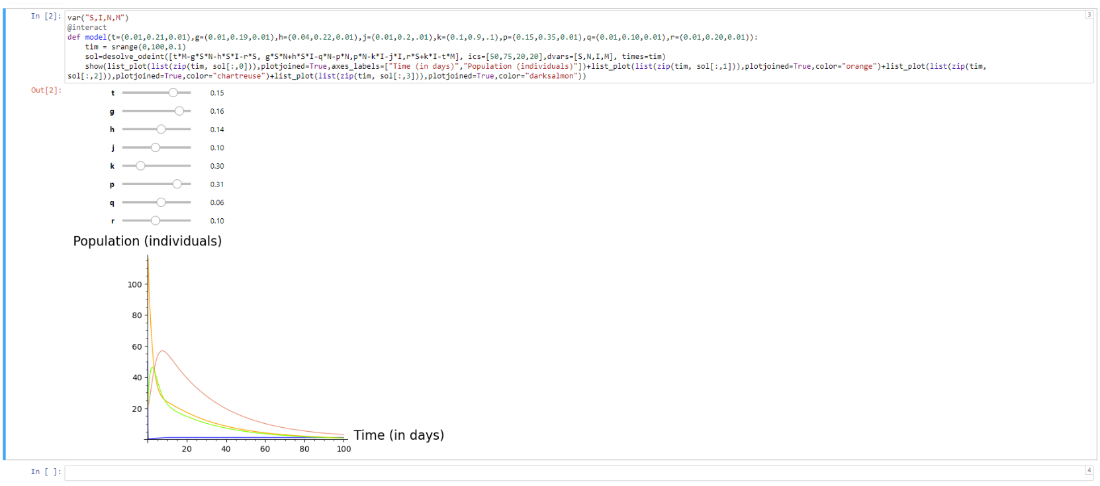
Simulations: Differing Parameter Values

Slide 9
Simulation Observations
Changing parameter values changes the relative proportions of each group in the model but the end behavior remains a constant value (all populations approach a constant value over time).
Changing initial conditions changes the population values of each group in the model but the graph remains the same otherwise. In the long run, the immune group represents the majority of the population.
No oscillations because our system of equations does not have steep a enough negative feedback loop that would add oscillations to our graphs

Slide 10
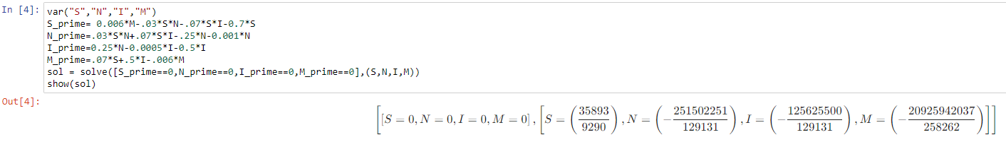
Stability Analysis: Equilibria
Note: Only the equilibrium point (0,0,0,0) is viable when taking into account biological significance as the other equilibrium point requires negative population values.

Slide 11
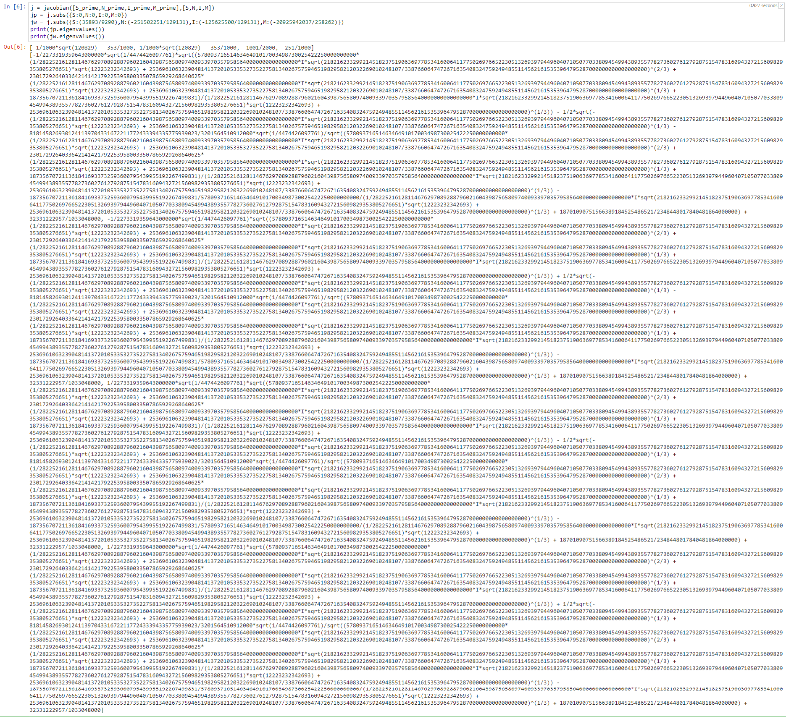
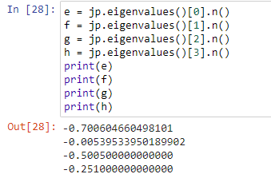
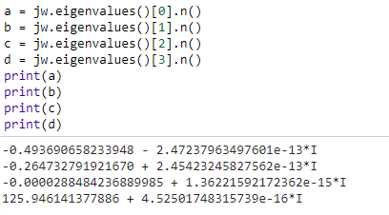
Stability Analysis:Finding Eigenvalues

Slide 12
Stability Analysis: Eigenvalues continued
Each of the eigenvalues associated with the point (0,0,0,0) are less than 0, indicating that the equilibrium point of the model at (0,0,0,0) is stable.
In the case of the eigenvalues for the point
3 of the eigenvalues contain a positive real part of the complex eigenvalue while 1 of the eigenvalues has a negative real part of the complex eigenvalue. This implies that the equilibrium point has a stability most similar to that of an unstable spiral.

